Slide 1

Special Event Application -Presented March 8, 2016

Slide 2
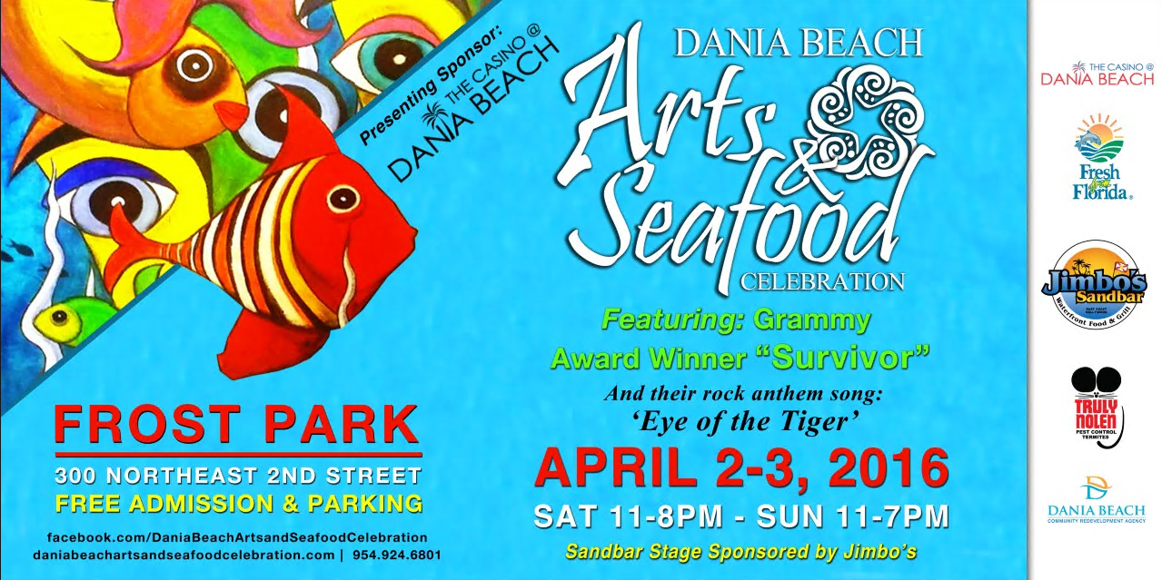
Arts and Seafood Celebration 2016

Slide 4

Arts and Seafood Celebration, 2016
Highlights
Extended Hours – Saturday Night
Street Art Competition
Two (2) Full liquor bars
National Headlining Act
29 Vendors; 90 Artists

